Slide 1

Flipkart Products Review Dataset
Flipkart Products Review Dataset
IS603 – Decision Making Support Systems
By (Group-2)
Vineeth Petnakota (RX82617)
Sravani Linga (OO40177)
Swati Roy (PR57930)

Slide 2

Project Description
Our project aims to develop a DSS application for Flipkart
The objective is to optimize supply chain management, inventory cost, and determine future scope using predictive analysis
Product reviews will be analyzed to improve product quality, customer service, marketing, advertising, and pricing strategy
Dashboard visualization will assist sales managers in making informed decisions about purchases, discounts, and future sales
The dataset includes consumer comments and helps maintain inventory levels for profitable goods
Inventory data, such as number of purchases and product categories, will be analyzed
Sentiment analysis will be used to provide insights into customer sentiment, increase customer satisfaction, and drive sales for Flipkart

Slide 3
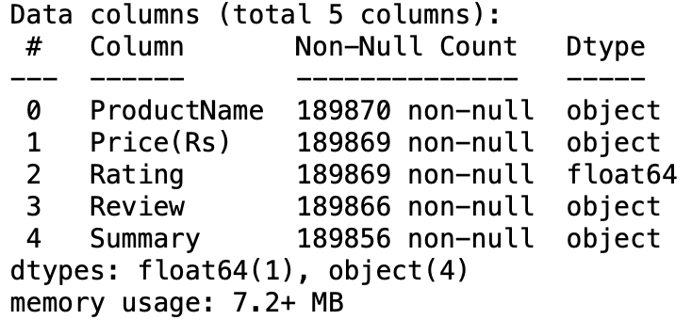
Dataset Description
Dataset-related information:
Link:https://www.kaggle.com/datasets/mansithummar67/flipkart-product-review-dataset
This dataset contains a total of 104 types of different products on flipkart.com.
There are total number of 194276 rows and 5 columns.

Slide 4

Data Preprocessing
The preprocessed dataset has 189874 rows and 5 columns, which is 4402 rows less than the original dataset.
Data has undergone pre-processing and analysis. Some preparation has been done, such as removing unwanted symbols(?ˇ?ˇ) in the ProductName column so the readability and meaningful product name is obtained. And also unwanted (É??)(‚?π) symbols in the price column has been eliminated so only numeric values in the prices have been updated in the preprocessing phase.
Apart from the above pre-processing in the Rate column had string data which must have only numbers, the unwanted string data (Bajaj DX, Nova favourite etc) strings have been eliminated and only numeric data is obtained in the Rate column which is now easy to analyse.

Slide 5
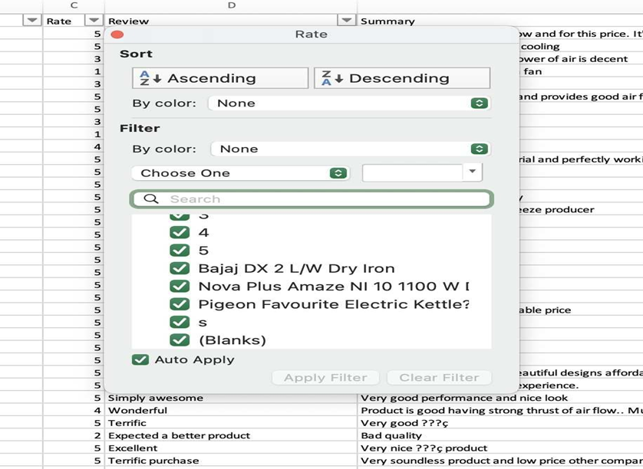
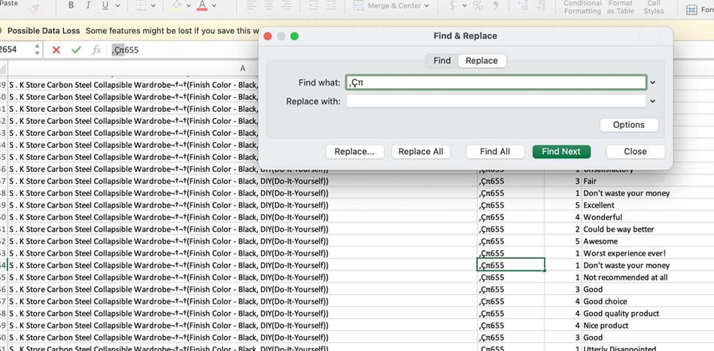
Data Before Preprocessing

Slide 6
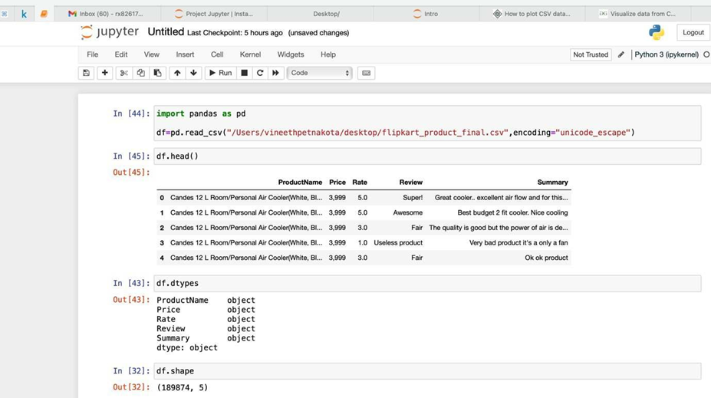
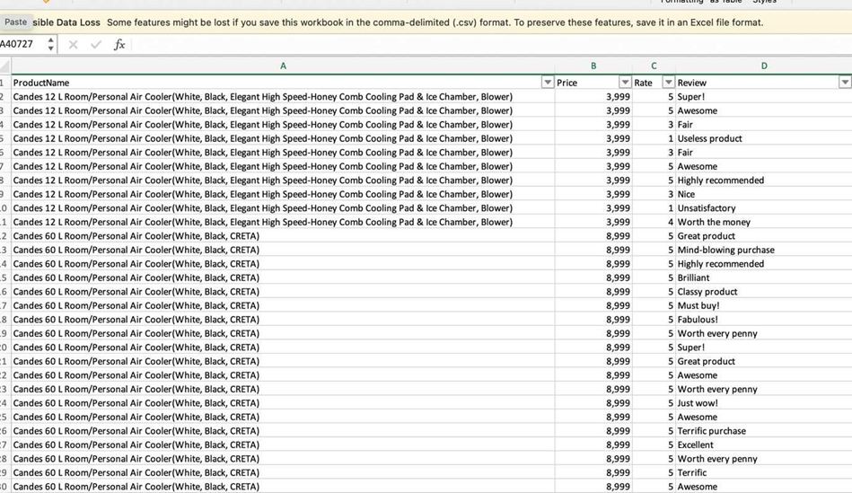
Data After Preprocessing
Data After Preprocessing

Slide 7




Sentiment Analysis
Sentiment Analysis using Textblob python library from nltk to analyse textual data.
Our project's sentiment analysis focuses on reviews.
We looked at positive, negative, and neutral reviews. So that we may more precisely identify product reviews.
Using Customer Review or Summary you can use it for sentiment Analysis purposes which gives us an idea about whether a product should be purchased or not based on Positive, Negative Reviews.

Slide 8
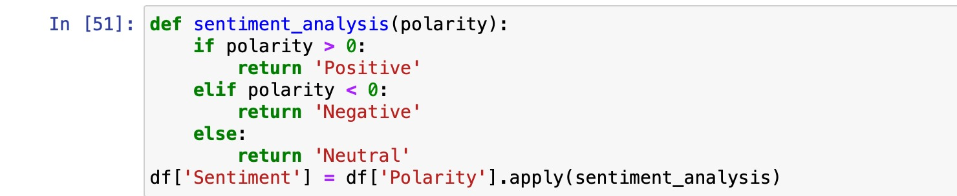
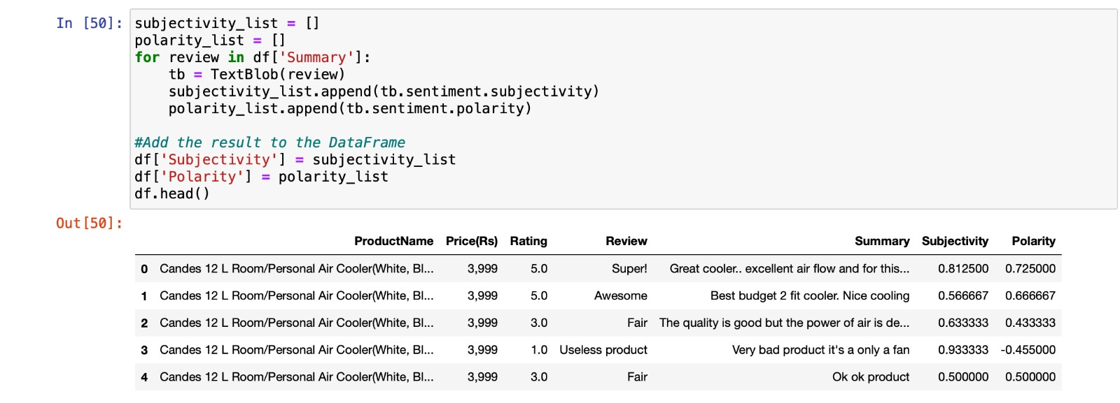
Code snippets for sentiment analysis using Textblob

Slide 9
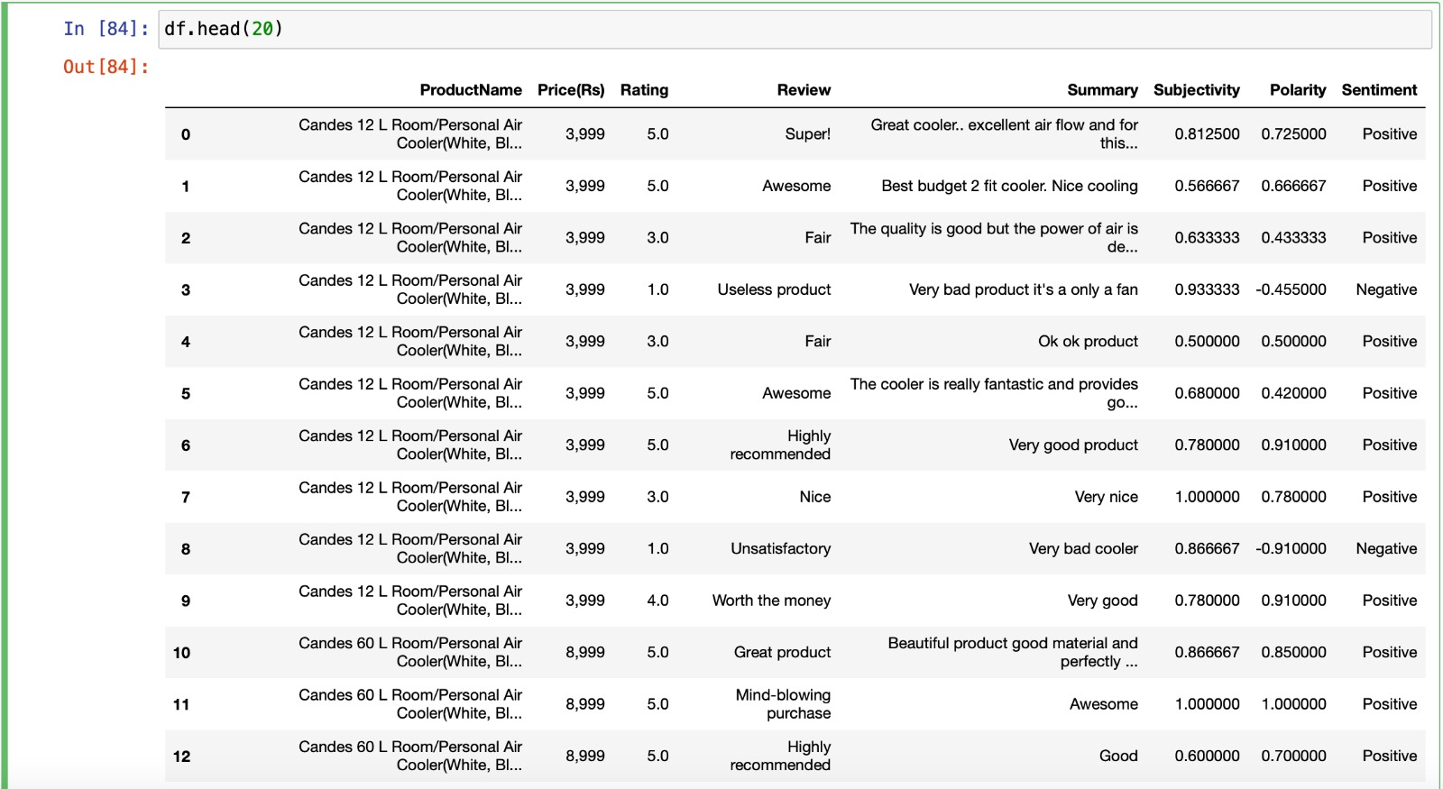
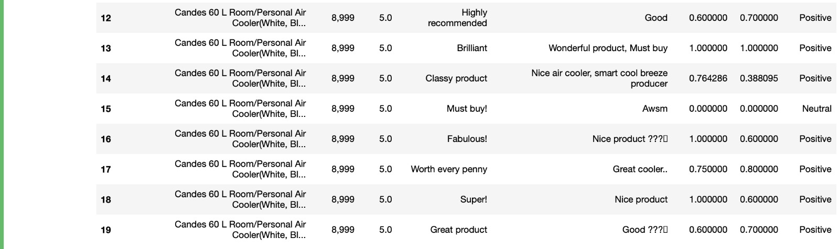
Code output with sentiment analysis

Slide 10
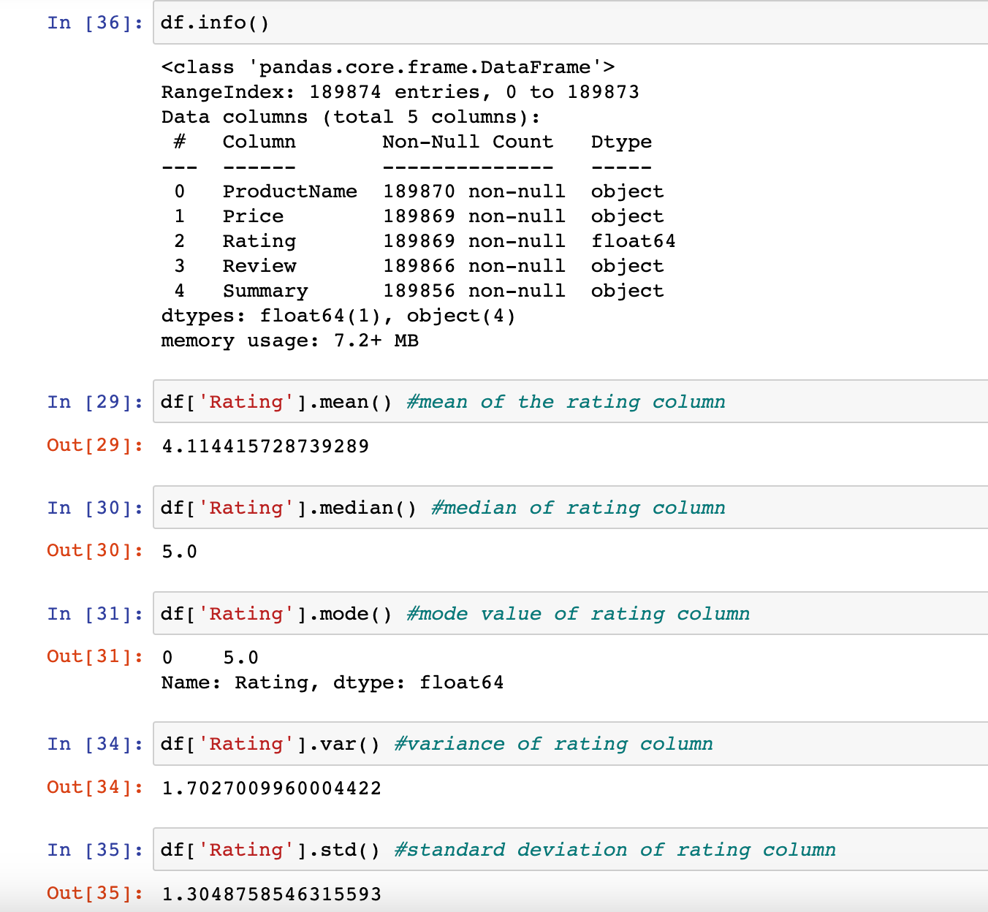
Statistical Analysis
We did statistical analysis for this data set in terms of
Arithmetic mean
Median
Mode
Dispersion
Range Variance
Standard Deviation

Slide 11

Visualization
Quantitative Data Visualization was used in our project. Based on the review and summary, we used the comparative technique for the various product names.
The product was compared based on review comments (excellent to worst reviews).
Our data was best shown using Bar chart.
This will assist to decide if the product with the highest rating and the most reviews can be handled more effectively to improve sales, while the product with the lowest rating will focus on marketing strategy to raise sales.

Slide 12
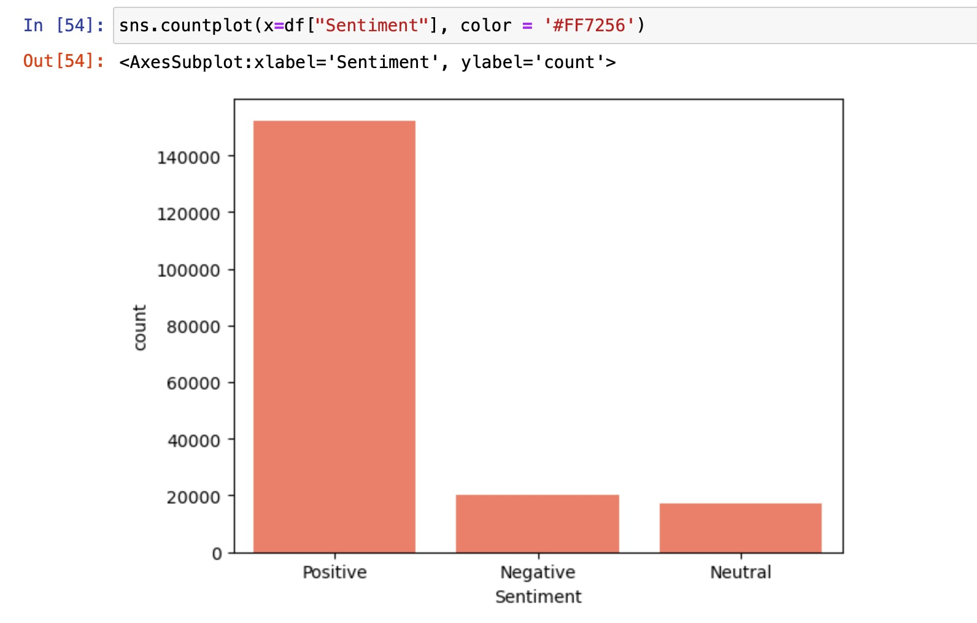
Positive,Negative and Neutral Review Graph

Slide 13
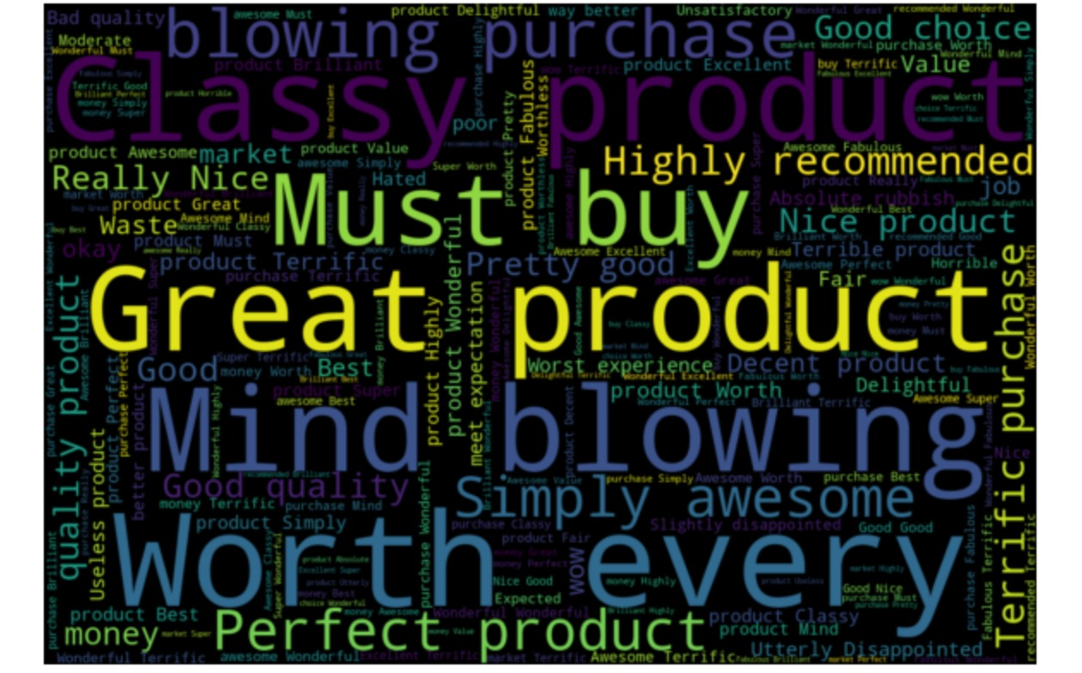
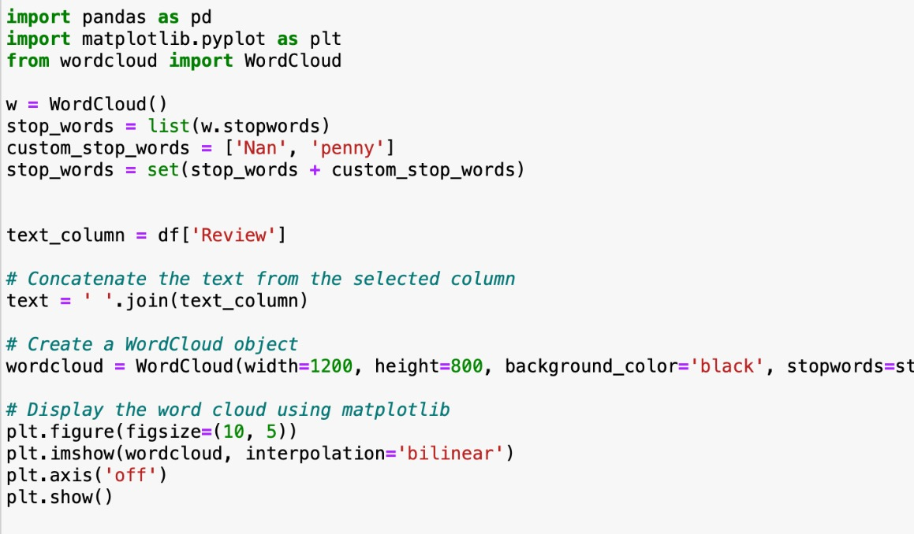
Word Cloud

Slide 14
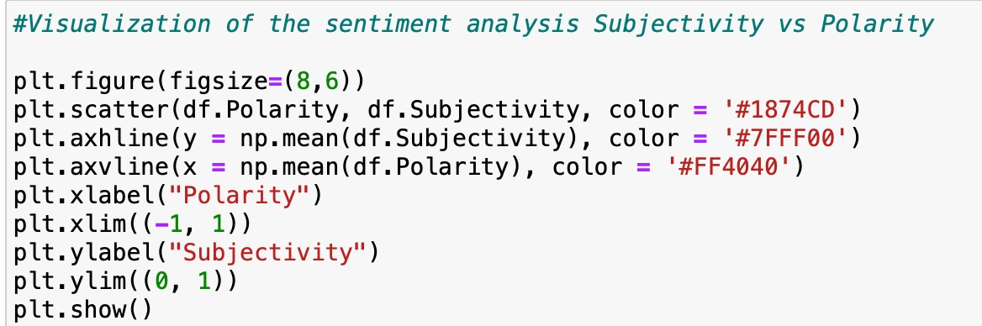
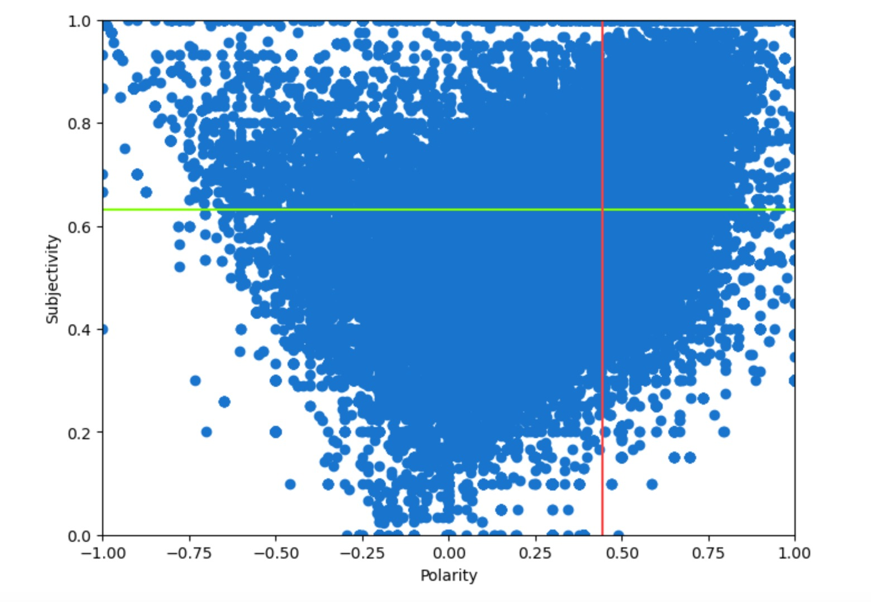
Sentiment Analysis plot with subjectivity vs Polarity

Slide 15
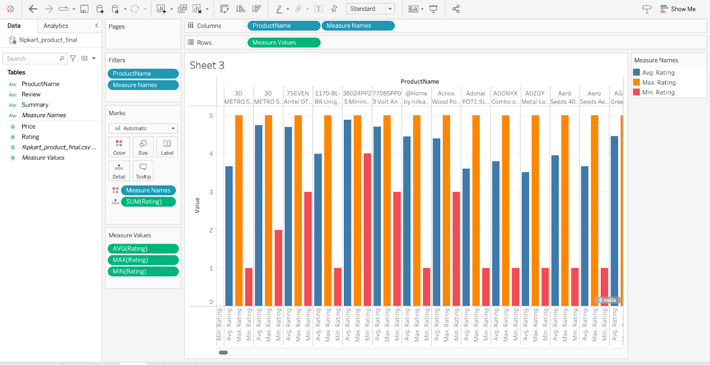
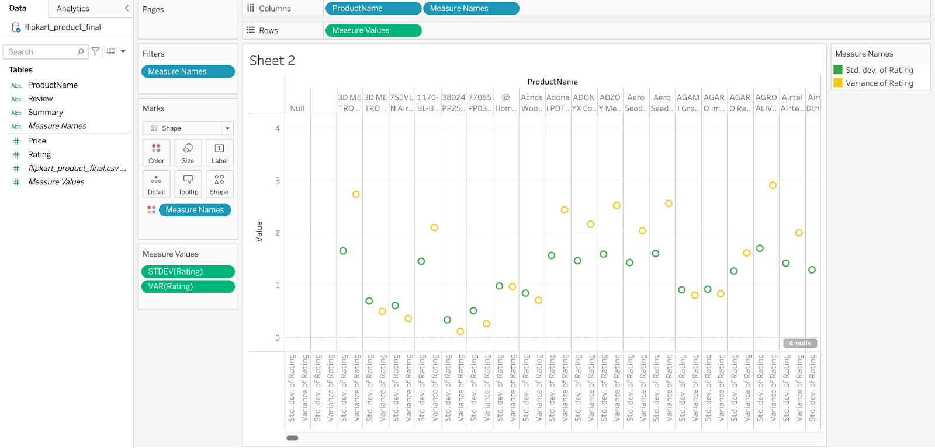
Each Product based on min , average and max rating
Standard deviation and variance of the products

Slide 16
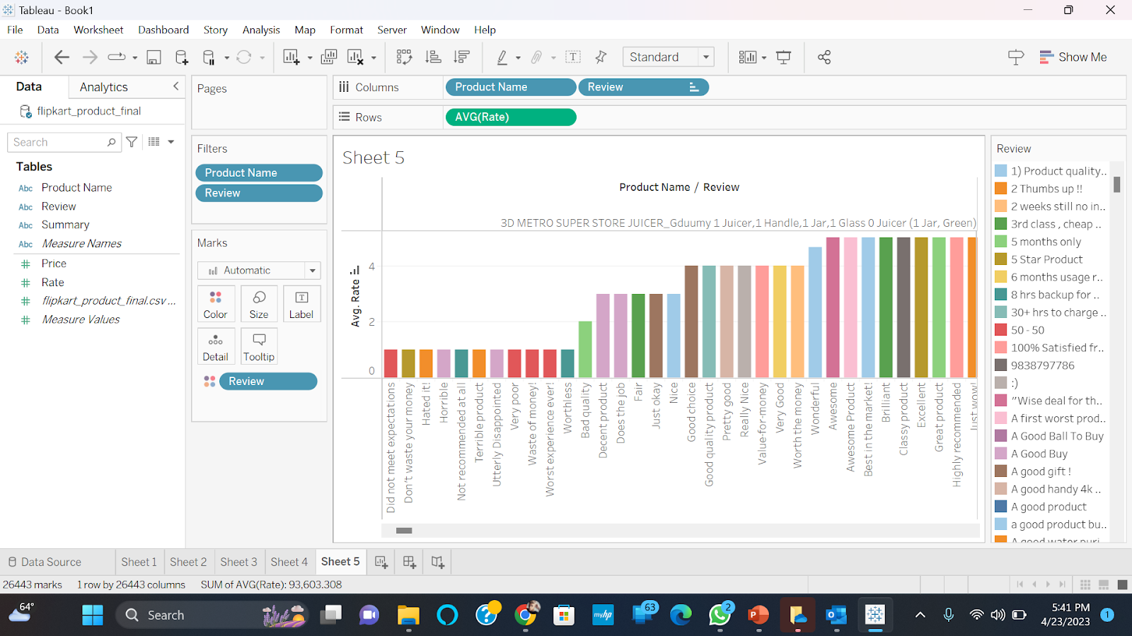
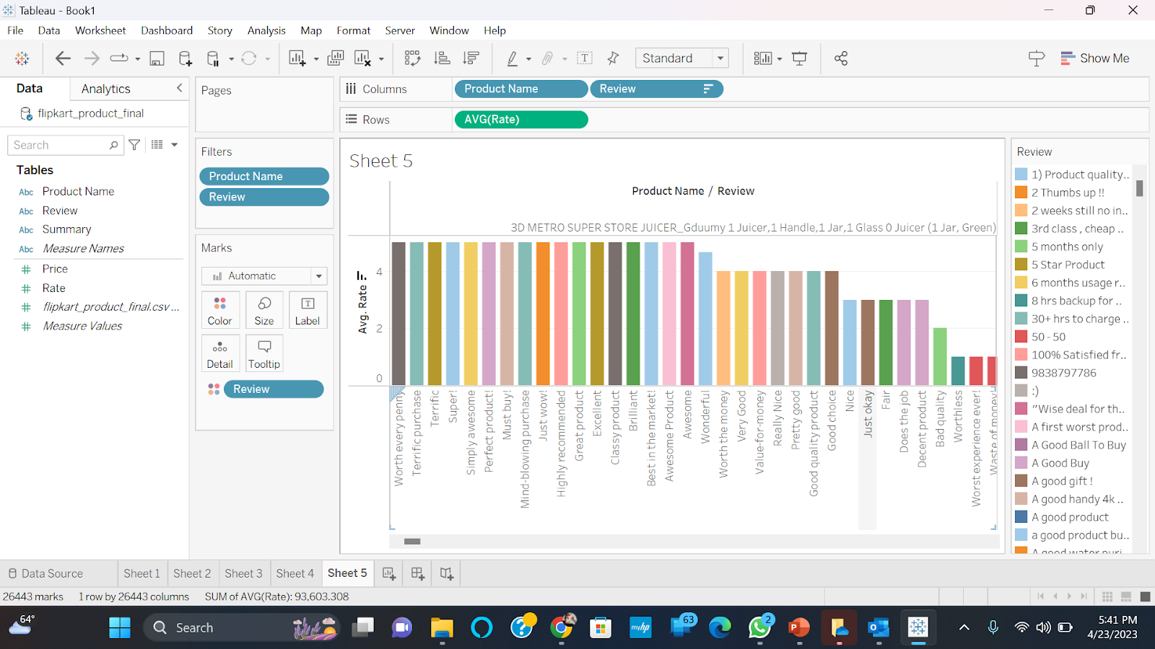
Product based on lowest review
Product based on maximum review

Slide 17

Limitations
Dataset limitations:
Limited scope: Due to portion of the platform's products are available for a limited time.
Our model have shown sentimental analysis for the over all data but our analysis was not able to show the sentimental analysis for each product wise.
Bias :The data set may be biased towards certain products or categories, as well as towards certain types of reviews or ratings.
Data Privacy: Flipkart may impose limits on the use of their data, and it is critical that any research or predictions based on the data conform with data privacy laws and regulations.

Slide 18

Thank You

